Slide 1

Awaken Inventory and Sales App
Milestone 1
Winston Biggs, Calvin Flippo, Justin Hill, Josh Kuehn, Hasani Mason, Chase Pavlu
@CompSciCodeGroup
Notes:
Winston Biggs, Calvin Flippo, Justin Hill, Josh Kuehn, Hasani Mason, Chase Pavlu
Awaken LLC
CompSciCodeGroup

Slide 2
Home Screen
The home page will have the ability to access the inventory and sales pages while also providing a starting place for whomever is using the software
This will help to keep the user from being overwhelmed with information as soon as they start the application
The home page will have some background decorations and will feature photos from the user’s projects

Slide 3
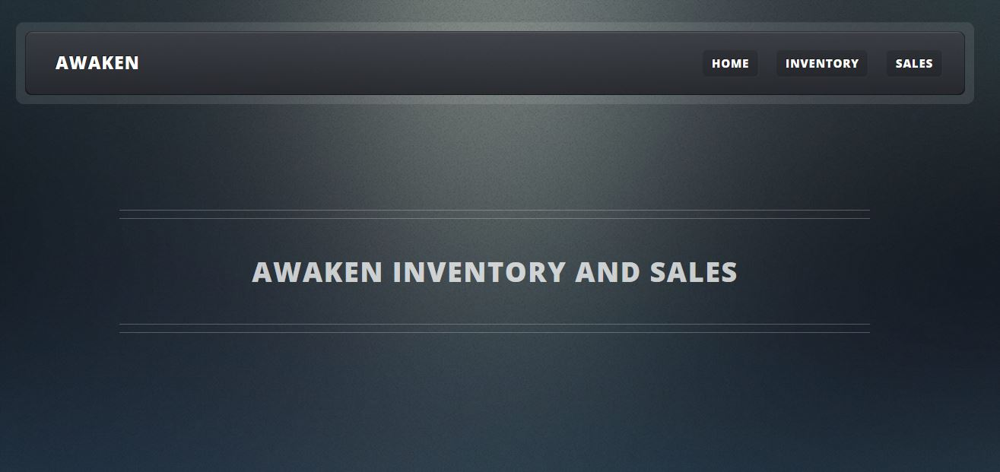
Prototype Home
Notes:
Default Home Page

Slide 4
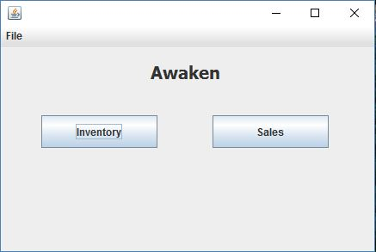
Inventory Overview
The inventory page may seem clustered in the swing GUI but this is not how it will remain after implementation for the purposes of this milestone only a prototype will be shown.

Slide 5
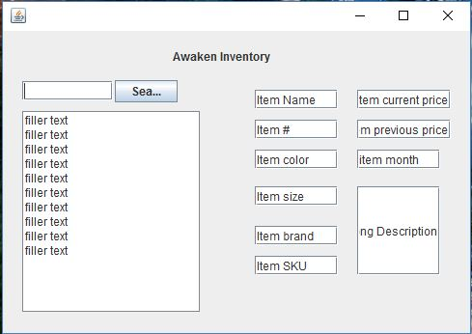
Item Number
Each Item will have an item number
This number will be generated by the system when a designer creates a new piece or the store acquires a new piece and will be representative of the item that was created most recently
The first item created by the designers will be 0001, this number will increase by one for each new item and will be used as a simple way of tracking all-time creations and store acquisitions

Slide 6
Style Number
The Style number will be generated by each designer rather than the system and will be used for quick and easy auto-population of certain item fields.
This number will also be used by companies that would like to make wholesale purchases of items for resale
The number will be generated using an internal numbering system consisting of a letter(F or S) and 6 numbers(XXX-XXX)
Each letter is representative of the season that the item was designed for Fall or Spring are the two seasons in which clothes are released

Slide 7
Style Number
The following six numbers will represent the gender for which the article of clothing was designed, the type of clothing that was designed, the material used in the making of the item, and the iteration of that item
The first digit will represent the gender for which the clothing was designed
1xxxxx - Men 2xxxxx - Women 3xxxxx - Unisex
The second digit will represent the type of clothing being created
x1xxxx - Pants x2xxxx - Shorts x3xxxx - Dress Shirts
x4xxxx - Dresses x4xxxx - Sweaters x5xxxx - Jackets
x6xxxx - Accessories

Slide 8
Style Number
Style number cont.
The third digit will be representative of the material used in creation
xx1xxx - Cotton Woven xx2xxx - Cotton Knit xx3xxx - Denim
xx4xxx - Silk xx5xxx - Blend xx6xxx - Leather
The last three digits will make up the iteration of the clothing and each will start at 1
xxx001 - First in this set of clothing
Putting all of this together we can see that a simple set of digits can explain a lot about a piece
113001 - Is the first iteration of a pair of men’s denim pants

Slide 9
Stock Keeping Unit(SKU)
Stock keeping units will be used internally as well but will be generated by the computer and will be used for queries. These will also use the industry standard numbering system and will include the style number plus 8 more digits
(F000000-XXXXXXXX)
The first 6 digits of the added 8 digits will represent the color of the clothing in hexadecimal while the last two digits will represent the size of the clothing
The first white, size four dress that is made of cotton and designed for a Spring release would have the SKU: S-241001-FFFFFF04
Using this method we can represent a lot of information in only 15 digits

Slide 10
Inventory Features : 1
The page will display only the search bar and empty list when first loaded and will allow the user to search the inventory by item number, item description or name, and by the brand label associated with each item.
Notes:
Added example pic

Slide 11
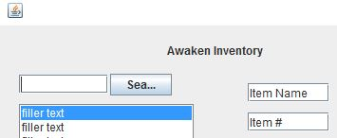
Inventory Feature: 2
This list will display and each item will be available to click and each item will have a small thumbnail and its item number displayed next to its name.
Notes:
Add example pic

Slide 12
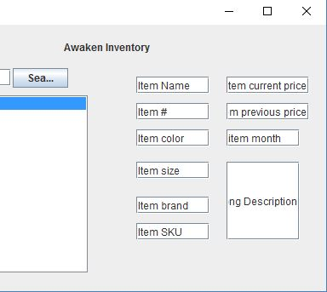
Inventory Feature: 3
When the item is clicked it will bring up the other panel which will display all information about the item in text fields so that the information can be edited and saved.
Notes:
Add example pic

Slide 13
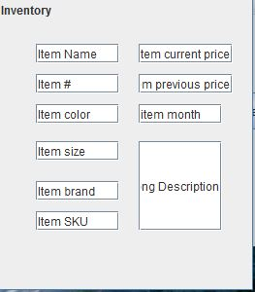
Inventory Feature: 4
When an item is saved it will store all the information currently in the text field after double checking with the user that the save is the option they would like to continue with.
Notes:
Insert Pic

Slide 14
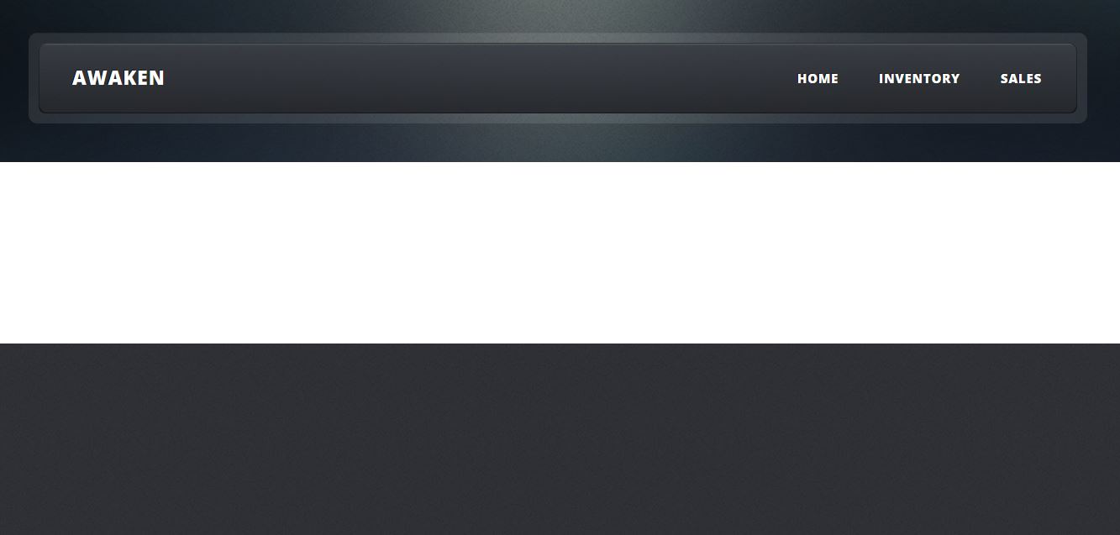
Inventory Feature: 5
This page will have a basic background and will be kept to a minimal level of clutter, it will be used not to distract or overwhelm the user accessing the inventory
Notes:
Insert pic

Slide 15
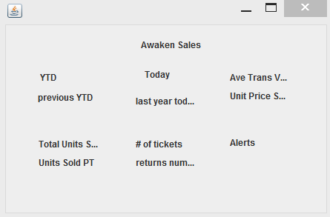
Sales Overview
On the sales page we will have six different panels. Each panel will display its own unique info that can be quite handy.

Slide 16
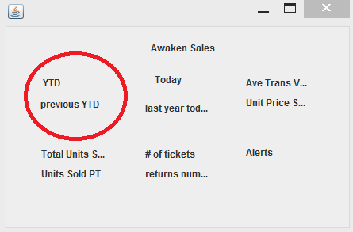
First Panel
This panel will show to current YTD in sales and also it will show the sales from the previous year.
This will make it easy for users to compare how they are doing this year vs last year at the same time.

Slide 17
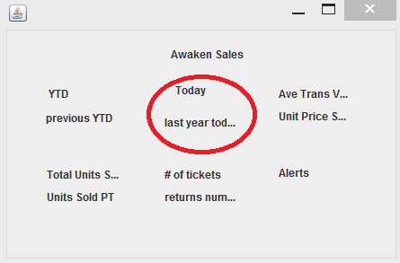
Second Panel
This panel will allow the user to select a date and compare it to the same date from the previous year.
This will allow a user to see if they are out performing how they did the previous year.
The second panel will also contain the name of the day.
Notes:
Tuesday will not be the same as sunday.

Slide 18
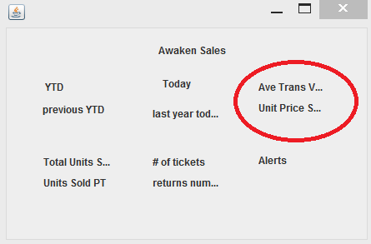
Third tab (Sales)
This will allow users to see the average transaction value for all previous transactions made. This could be show in a graph. This way the user could see the trend of transaction value over time.
This will be put with the average unit price and this graph laid over the other graph. This will give the user an idea about how much money they will be making off each piece.
Notes:
Market price

Slide 19
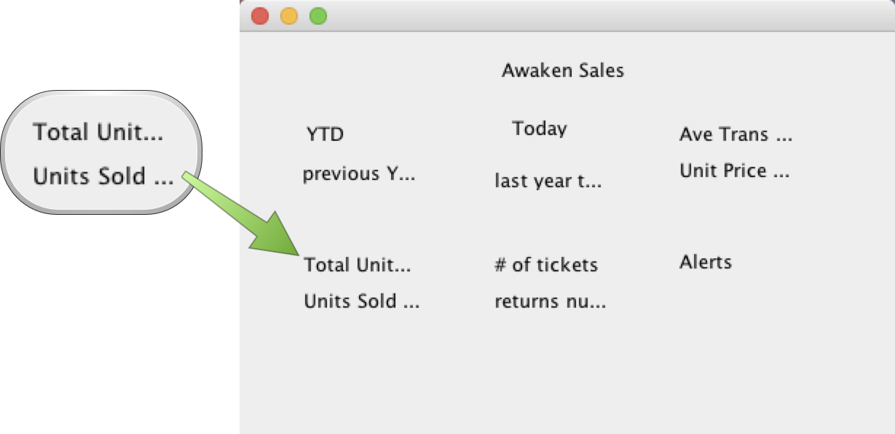
Fourth Panel
Total number of units sold, YTD units sold, monthly units sold.
Units sold per transaction to help identify prime sale periods vs when only a couple customers inflated store income.

Slide 20
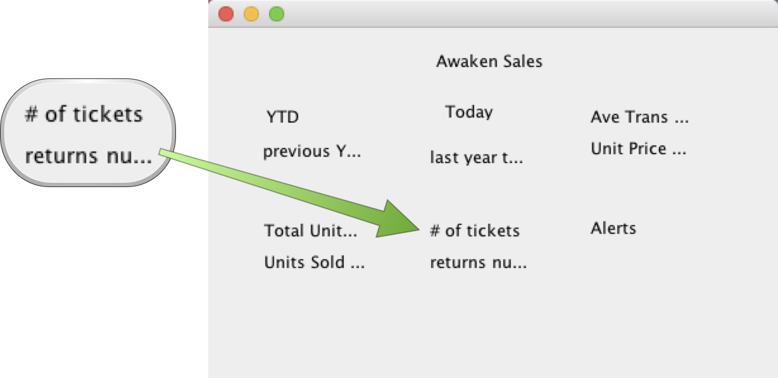
Fifth Panel
Shows the number of open tickets and number of returns.
Gives insight into what pieces of clothing are being returned the most so they can find a quick fix.

Slide 21
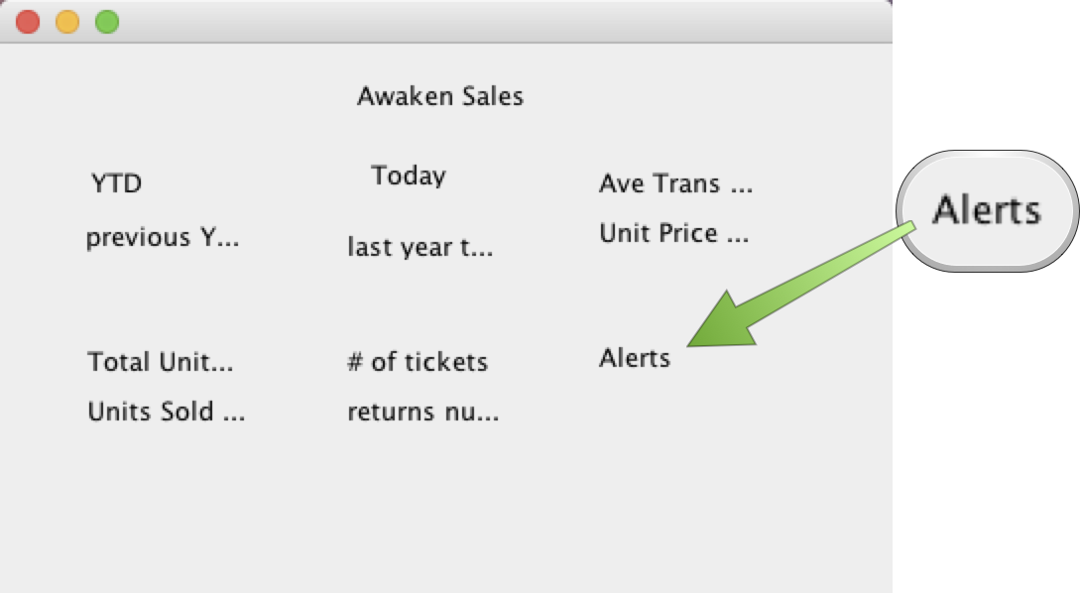
Sixth Panel
This panel will be used to display general alerts such as.
Number of returns in a 7 day period
YTD comparisons
User problems left in the system

Slide 22
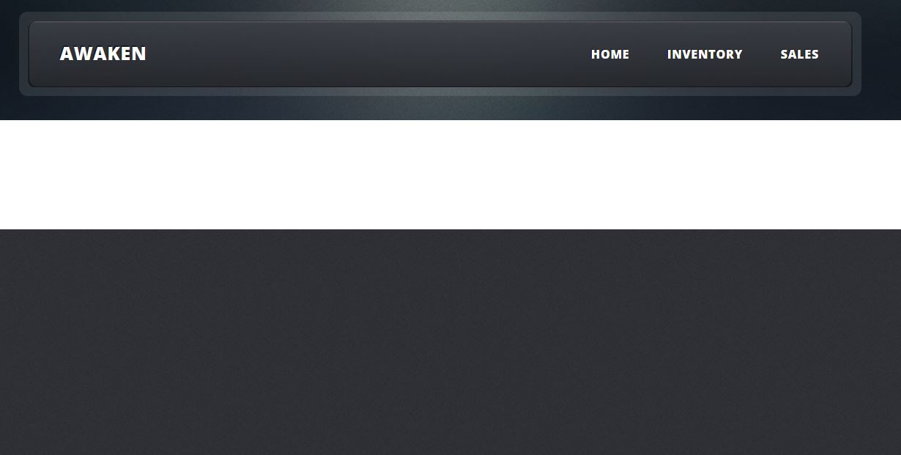
Sales Page Web GUI
This page will have a basic background and will be kept to a minimal clutter, so user are not to distracted or overwhelmed by accessing the sales data
Notes:
Default GUI

Slide 23
Implementing the HTML GUI
To implement the dashboards in the HTML GUI we will be using google charts to chart information and return a svg file this will allow us to display graphs that show the trends over time. Having the ability to easily see sales trends over time will make it easier for managers and accountants looking at the data to make assumptions and even plot future potential sales with much higher accuracy. This also allows for HTML to be laid over the GUI that will provide tool tips that can offer even greater functionality.

Slide 24
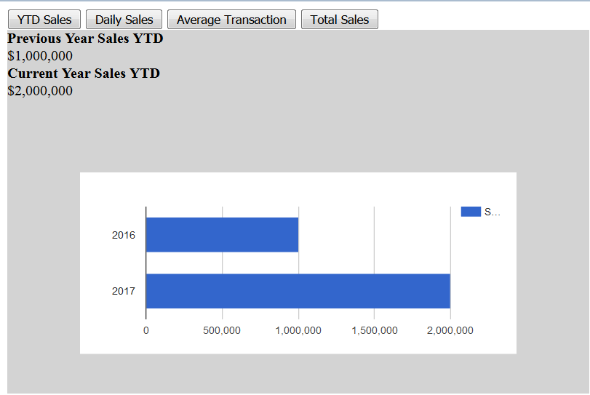
Implementing the HTML GUI
The overall look and feel of the GUI dashboards will follow this trend and will allow for quick switching between the sales information for the user

Slide 25
HTML GUI
JavaScript
function drawChart1() {
var data = google.visualization.arrayToDataTable([
['Year', 'Sales'],
['2016', 1000000],
['2017', 2000000]
]);
var options = {
chart: {
title: 'YTD Sales',
subtitle: '2016 and 2017',
},
bars: 'vertical' // Required for Material Bar Charts.
};
var container = $(" #firstTab .chart")[0];
console.log(container);
var chart = new google.visualization.BarChart(container);
chart.draw(data, options);
}
Here is a bit of code from the implementation of the GUI you just saw. This is the general idea we will follow for future implementation
HTML5
<div id="firstTab" class="tab">
<label for="prevYTD"><strong>Previous Year Sales YTD</strong></label>
<span id="prevYTD" name="prevYTD">$1,000,000</span>
<label for="currYTD"><strong>Current Year Sales YTD</strong></label>
<span id="currYTD">$2,000,000</span>
<div class="chart"></div>
</div>

Slide 26
Additional Information
This business will be based on the web and will have no brick and mortar locations
The business owners would like to find some way to record and chart where each piece of clothing is going so they know where to target advertising and where their advertising has been most effective
Notes:
Good insights!

Slide 27
Additional Information
An effective way to add items to the inventory will be by using SKUs (Stock Keeping Units)
Made up of a style number and a color number
When entered will allow easy population of item information such as material, item number, season, size and gender
Notes:
God insights!

Slide 28
Additional Information
If we choose to implement a full database for this project we can use an online hosted database system or even a local SQL database system
The benefits of using an online database would be access to a dashboard
If we are able to get the HTML code up and running it will make access much easier
Notes:
Possible? We will see :)

Slide 29

Any Questions ?
Notes:
The End

